Slide 1
Visual-Based Navigation: Visual perception technique for autonomous systems.
Members:-
Swadha Swaroop(112201009)
Mausumi Bhuyan(122201001)
Mentor: -
Dr. Shaikshavali chitraganti

Slide 2
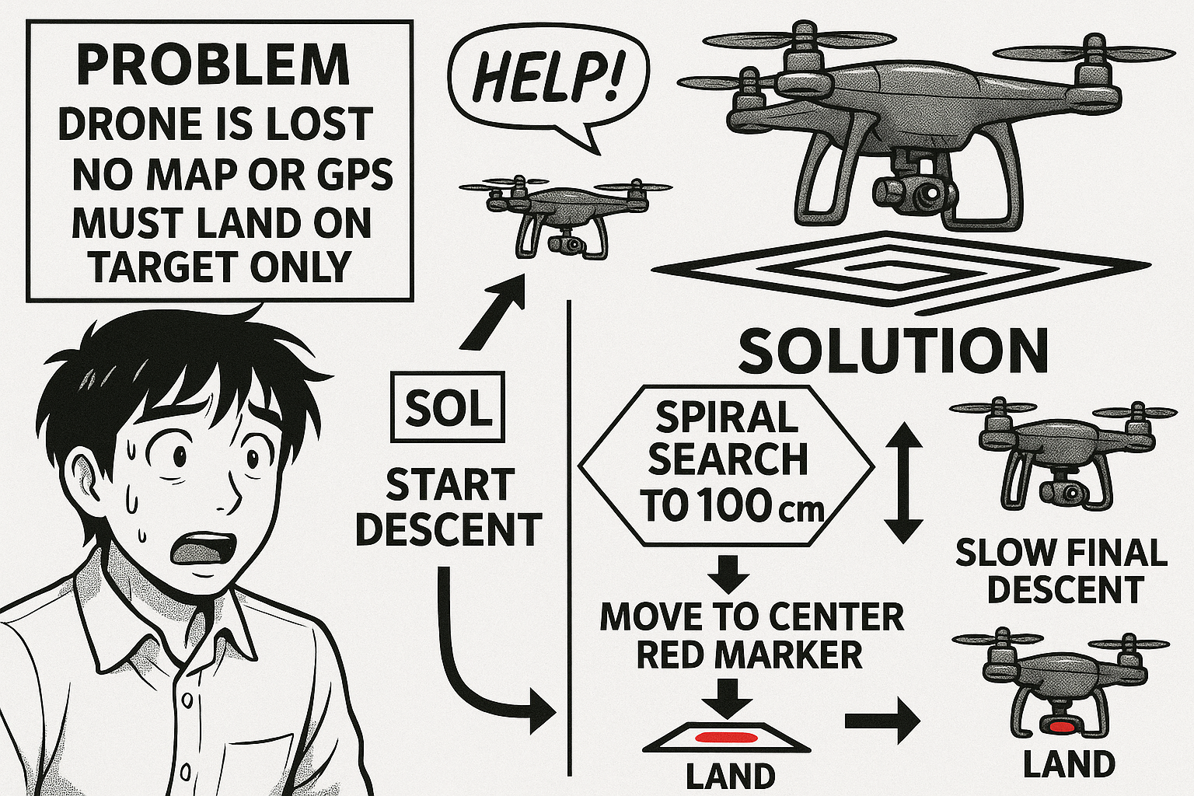
Visual-Based Navigation: Visual perception technique for autonomous systems.
Current Limitation: Drones depend on GPS and internet for navigation.
Risks: Susceptible to jamming, tracking, and failure in critical scenarios (military, disaster zones, space).
Objective: Develop a vision-based algorithm for autonomous navigation and landing.
Advantage: Operates independently of GPS or network connectivity.

Slide 3
Objective
Implement GPS-independent autonomous drone landing
Use onboard camera to detect a colored landing marker
Enable spiral search, target centering, and precise descent.
Works in complex, dynamic terrains without external markers Reliable, low-cost, and GPS-independent solution
Algorithm
Spiral search When the target is not immediately visible, the drone executes a spiral flight pattern—expanding its search radius from the current location. This ensures that the drone can systematically explore the surrounding area until the colored landing marker is detected.
Target detection and precise descent Upon detecting the landing marker, the drone uses image processing techniques (such as color filtering and shape recognition) to continuously track the target's position relative to the drone. It adjusts its position to center over the marker and performs a smooth and controlled vertical descent, ensuring an accurate landing.

Slide 4
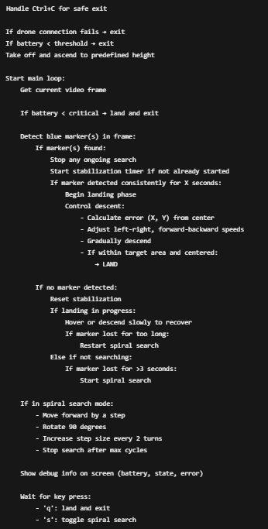
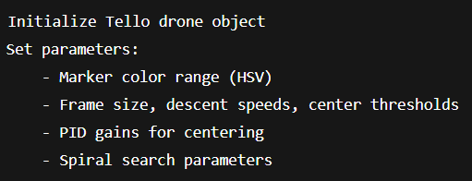
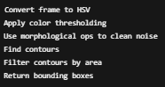
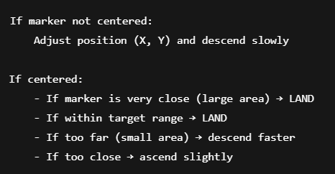
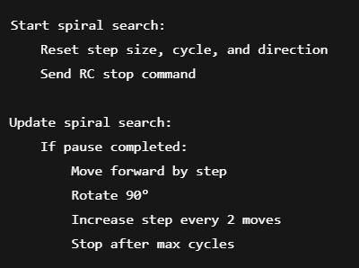
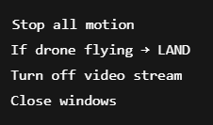
2. Running of the Drone
1. Initialization of Drone
Algorithms
Initialization of drone
Running of drone
Marker Detection
Spiral search
Landing Control
Cleanup
3. Marker Detection
5. Landing Control
4 .Spiral Search
6 .Cleanup

Slide 5
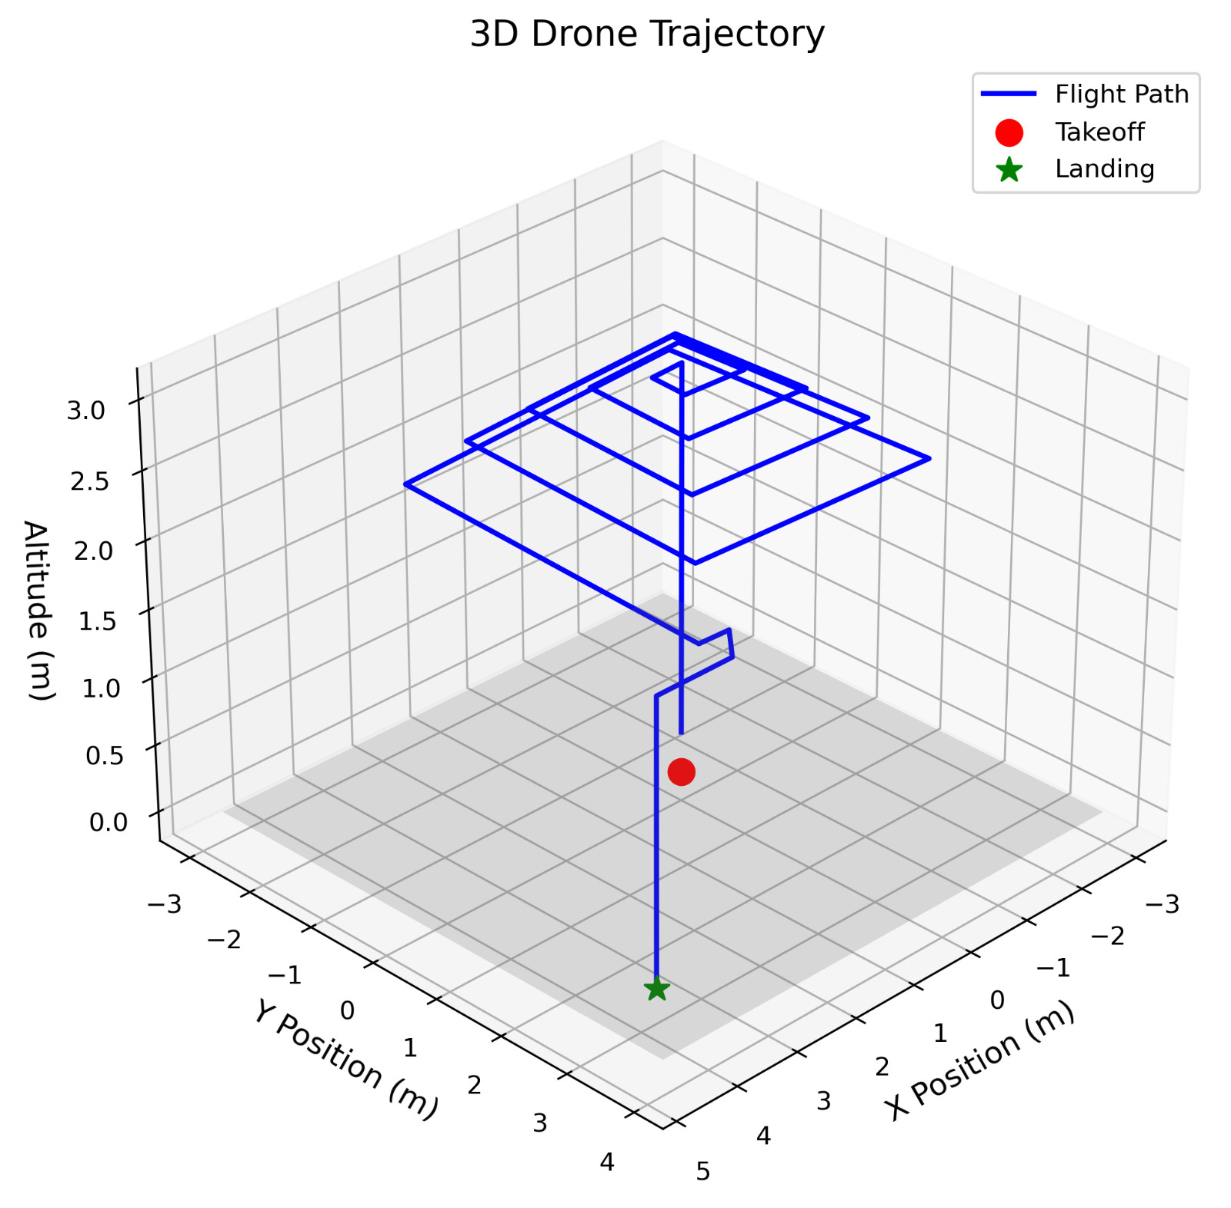
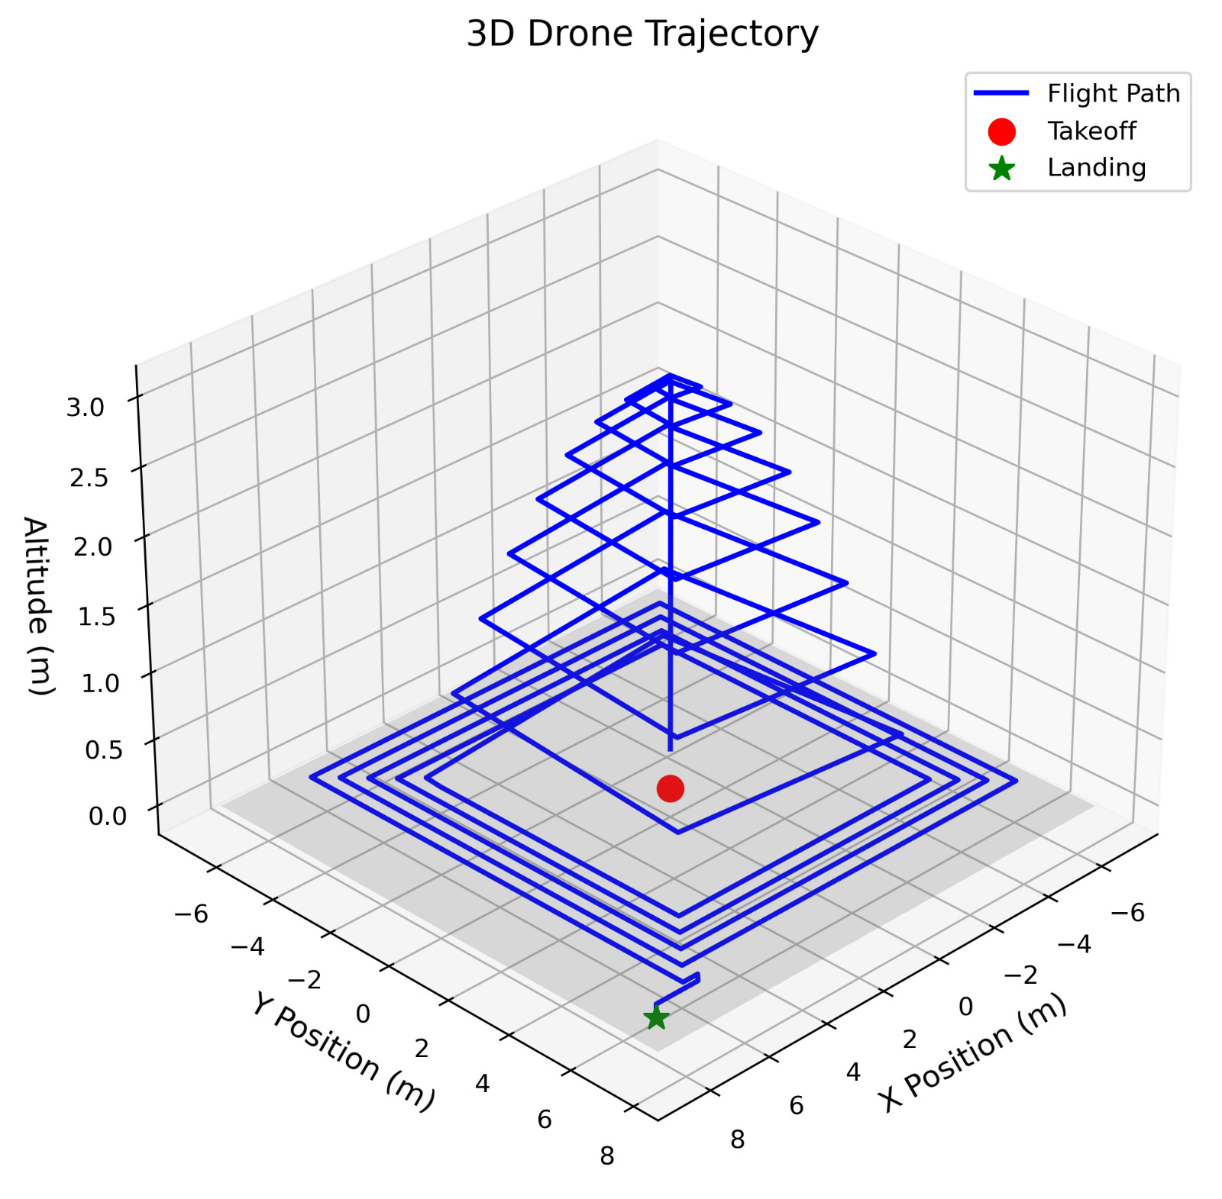
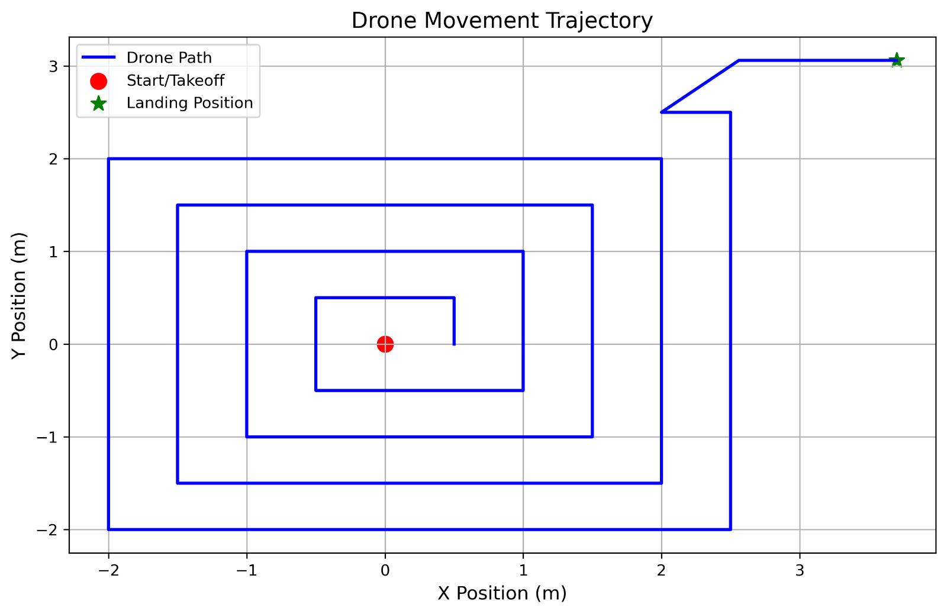
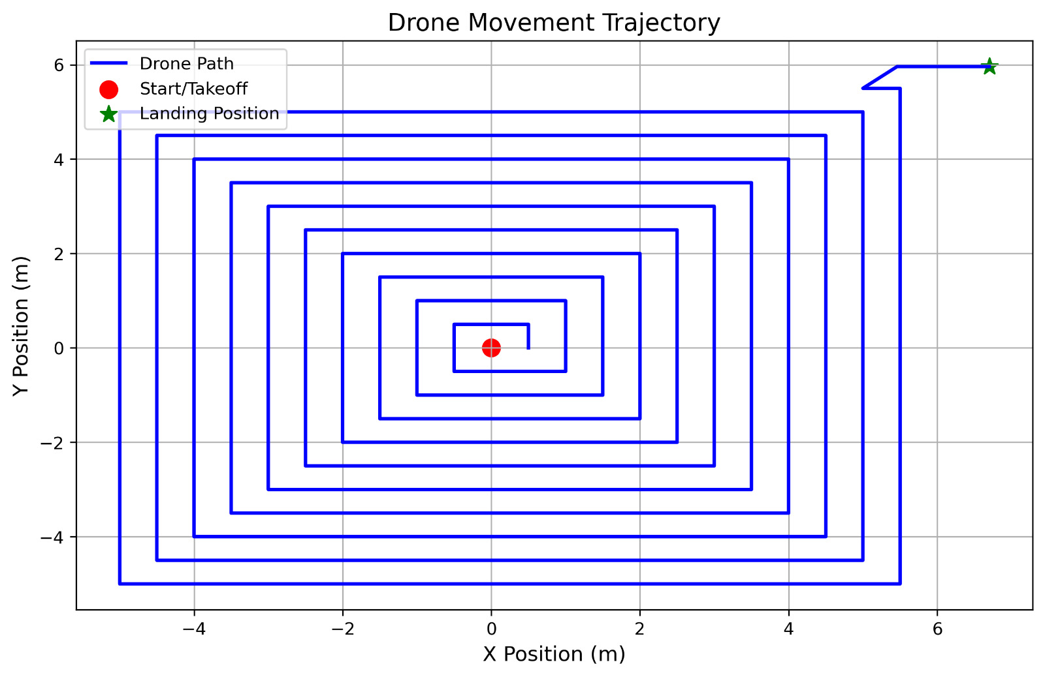
Movement Plots
3D view of the movement
Top view of the movement

Slide 6
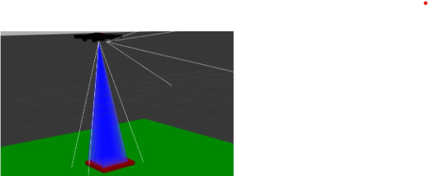
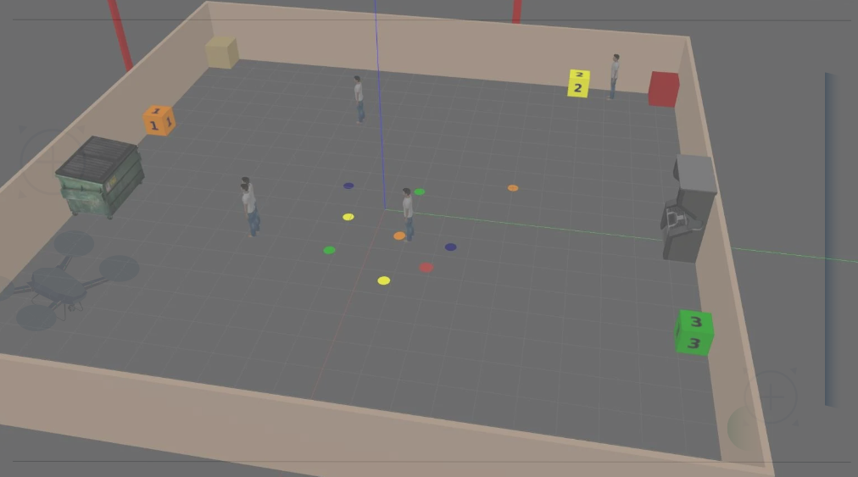
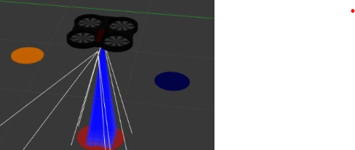
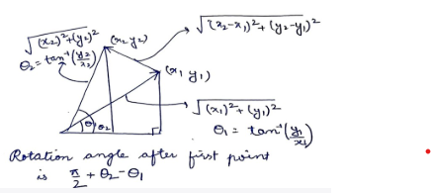
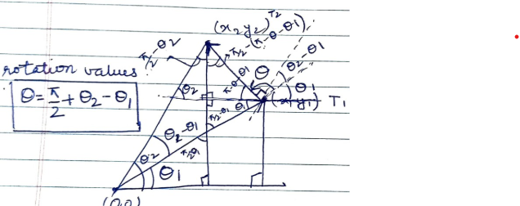
Previous Simulation
Earlier we implemented it on sjtu-drone but due to unavailability of sjtu-drone we were unable to check it and thus we switched to the tello drone.

Slide 7
Tools
Hardware: DJI Tello Drone, Camera The project uses a DJI Tello drone equipped with a downward-facing camera(we need to make changes since it doesn’t have an inbuilt downward facing camera. The drone is compact, programmable, and suitable for indoor testing, making it ideal for prototyping GPS-independent solutions.
Language: Python
Libraries:
OpenCV – For real-time image processing tasks such as color filtering, contour detection, and object tracking.
djitellopy – A Python wrapper to interface with the DJI Tello drone, providing commands for flight control and accessing the video stream.
NumPy – Used for efficient numerical operations and handling arrays derived from image frames.
Platform: Local System with Real-Time Video Feed

Slide 8
Limitations
Single Color Detection The system is currently configured to detect only a predefined, single-colored marker (e.g., blue). It does not adapt to multi-colored or patterned markers.
Marker Visibility Required The landing marker must remain fully visible and unobstructed. Partial occlusion or obstacles covering the marker can lead to failure in detection.
No Obstacle Avoidance The drone lacks any active obstacle detection or avoidance mechanism. It will not recognize or react to objects in its path during flight or descent.
Lighting Sensitivity Detection performance may significantly degrade in low-light or overexposed conditions, as color-based image processing heavily relies on consistent lighting.
Basic Spiral Search The spiral search algorithm is time-constrained and designed for relatively simple terrain. It is not optimized for highly irregular or dynamic environments where adaptive exploration strategies are needed.
No Angle Compensation The current system assumes a mostly vertical camera view. It does not yet account for camera tilt or angular distortions, which can affect the accuracy of marker localization if the drone is not level.

Slide 9
Demonstration
1. Drone placed at a small distance from the Marker in a clear surrounding :-
https://drive.google.com/file/d/1d5VNQ4AXtlCkLbcsV3M2A_9sMyjo9RLF/view?usp=drive_link
2. Drone placed at a large distance from the Marker in a clear surrounding :- https://drive.google.com/file/d/1MsQxmPamEzLUTUpf8aYCyQy7M4LTFkyZ/view?usp=drive_link
https://drive.google.com/file/d/1ua-TeADF6WbbHnBbU23NabSfaDr-NxlO/view?usp=drive_link
3. Marker placed at a random place in a room :-
https://drive.google.com/file/d/11duUHr3Ri1BNLfCvV2JJ_RMQ8piQWrOt/view?usp=drive_link
https://drive.google.com/file/d/1V4LByd_AjmcDa0cdlYgwQF3GTrD1ahAa/view?usp=drive_link
4. Smaller marker placed at a random place in room :-
https://drive.google.com/file/d/1yH69txxR3IlLce62chg95ZQFtQqELzKT/view?usp=drive_link
5. Drone placed outside :-
https://drive.google.com/file/d/1eICmuyRogptbB_iLpfOzMf5IyPNLoxrm/view?usp=drive_link
https://drive.google.com/file/d/1_aR2iU2Cp0JV-stDW7xQBctnXXEcu6Ug/view?usp=drive_link
https://drive.google.com/file/d/1Gtta13vwVH2capfO61m5lXyAPEBS1xJT/view?usp=drive_link
6. Using different marker as the same time :-
https://drive.google.com/file/d/1LqrqsAHC5vj2yeL44rnFE6wAQwItA166/view?usp=drive_link
Drive Link:-
https://drive.google.com/drive/folders/1rKlSrs1aT5kpTJHOXoW-QnA5ep1nt-Zh?usp=sharing

